Slide 1
Advances in SENSE with Arbitrary k-Space Trajectories
Jaeeun Lee
2018/11/07

Slide 2
Contents
Review - last meeting
Troubleshooting
CG loop
Coil sensitivity
Parameter adjustment
Next meeting

Slide 3
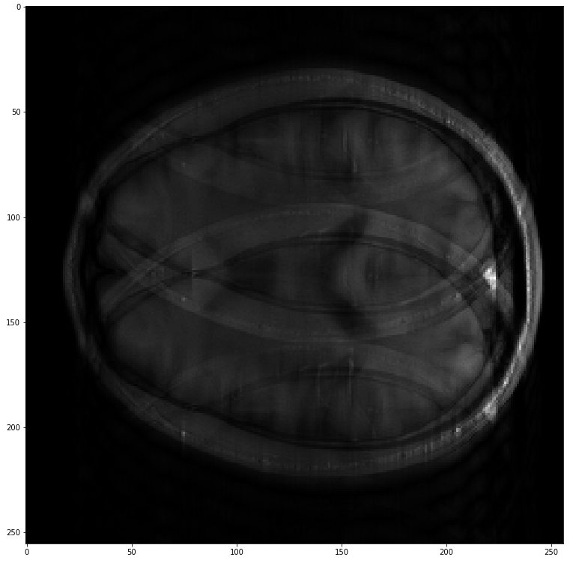
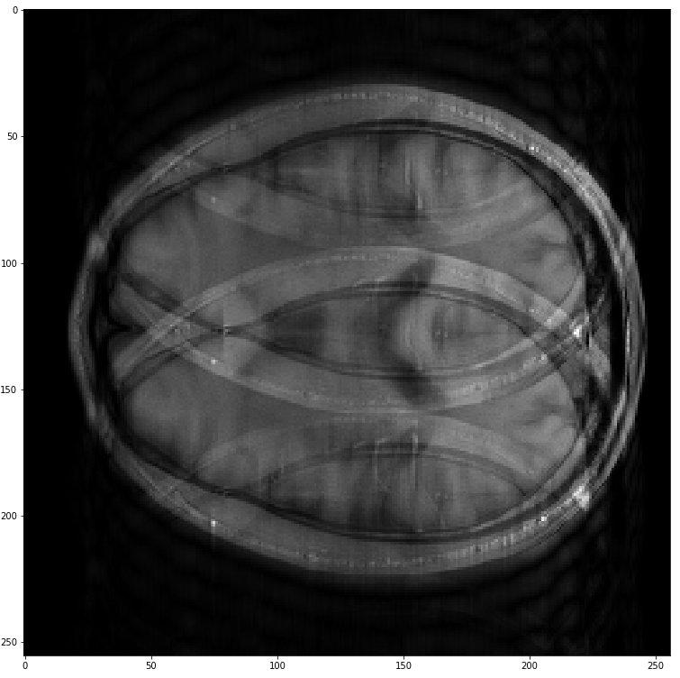
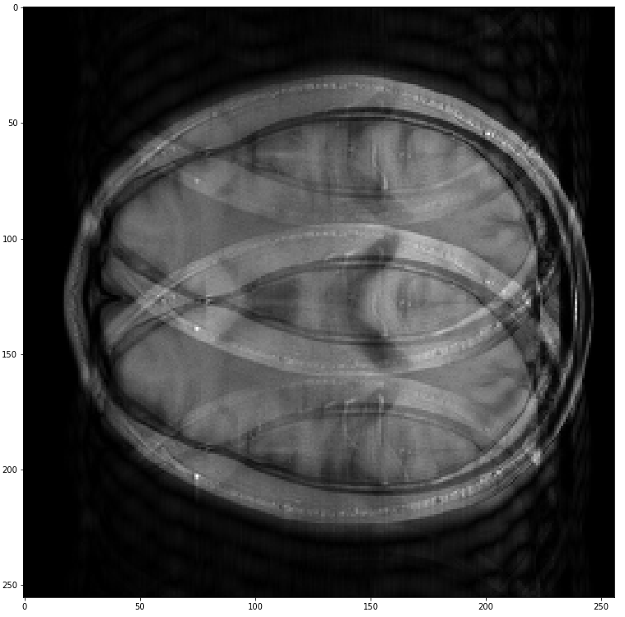
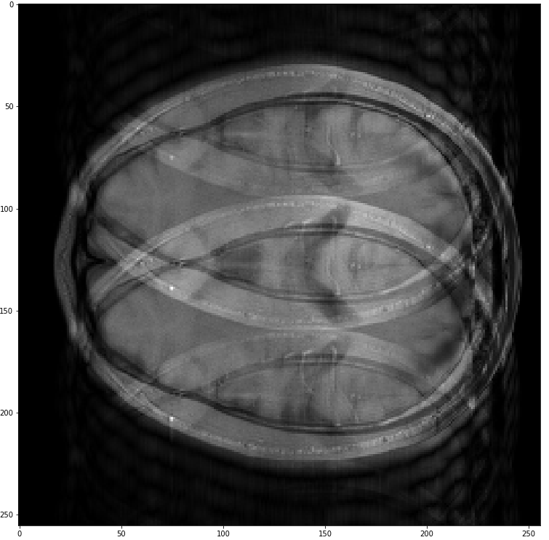
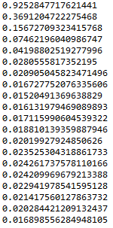
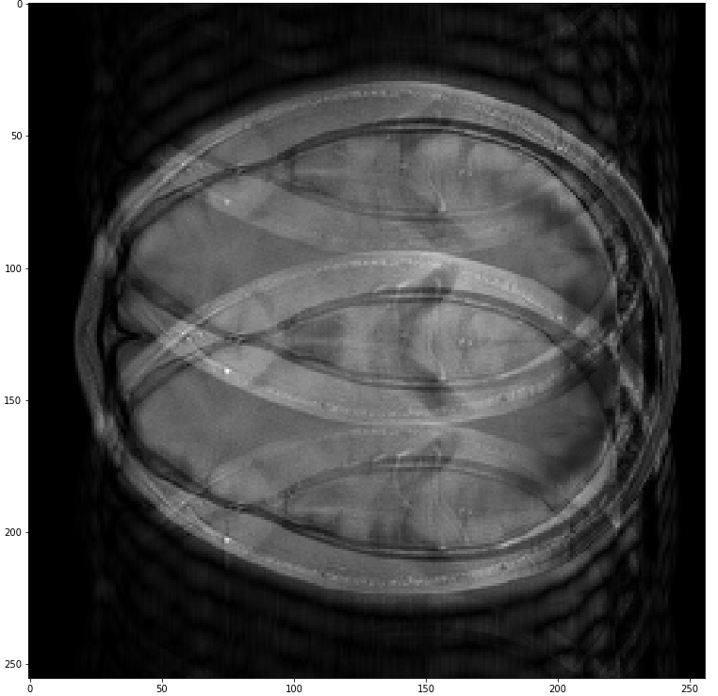
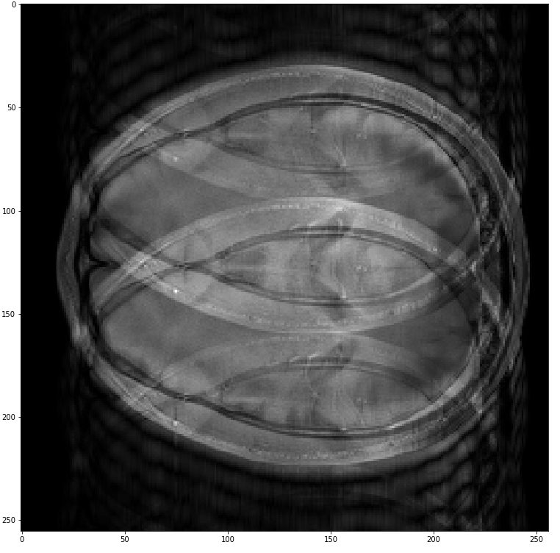
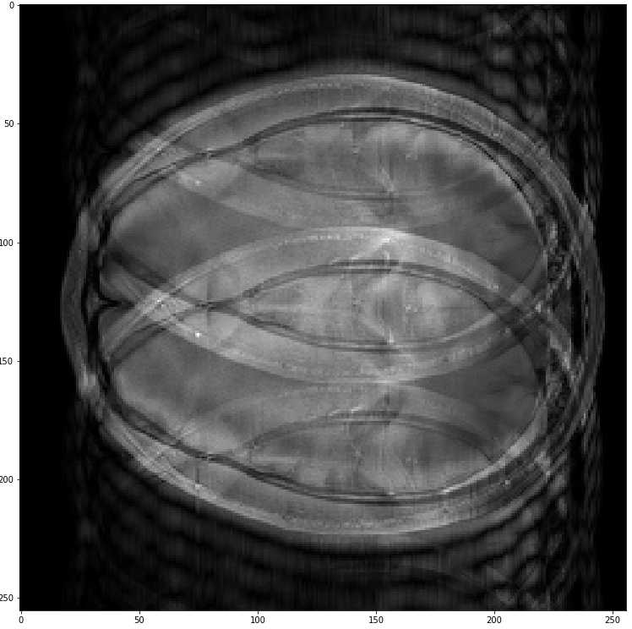
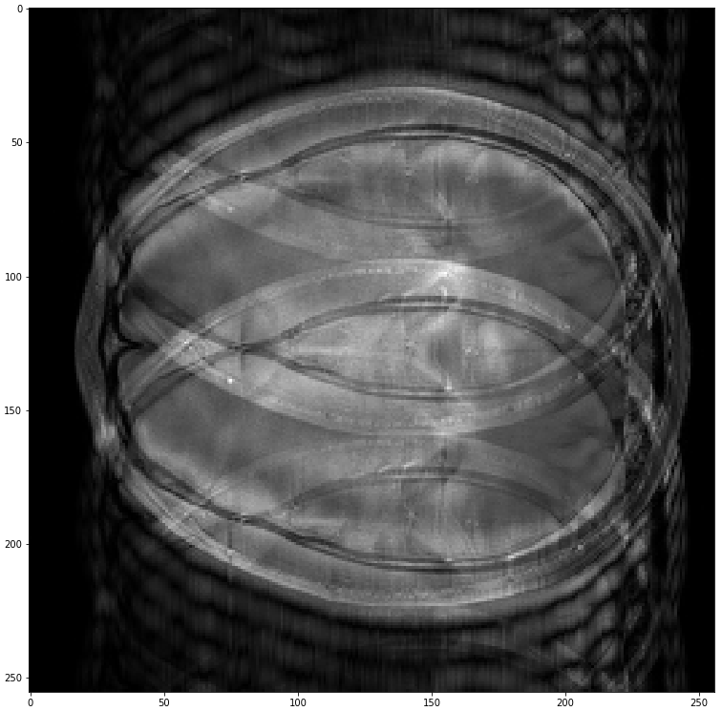
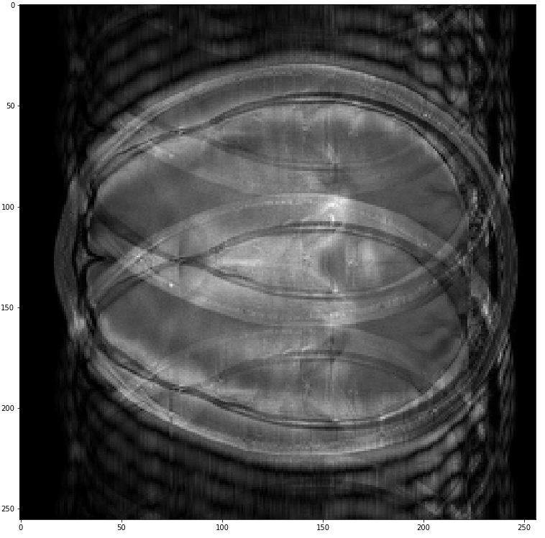
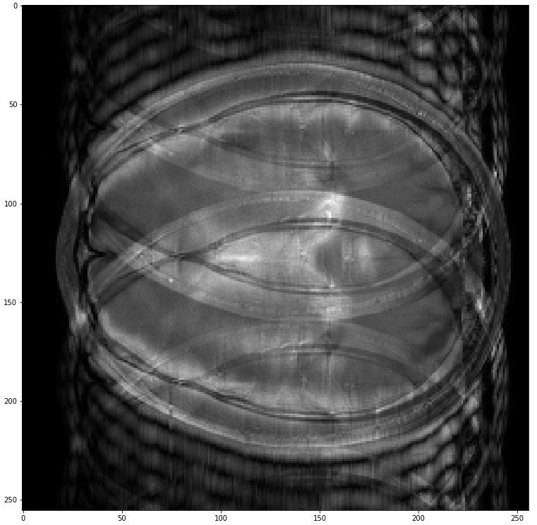
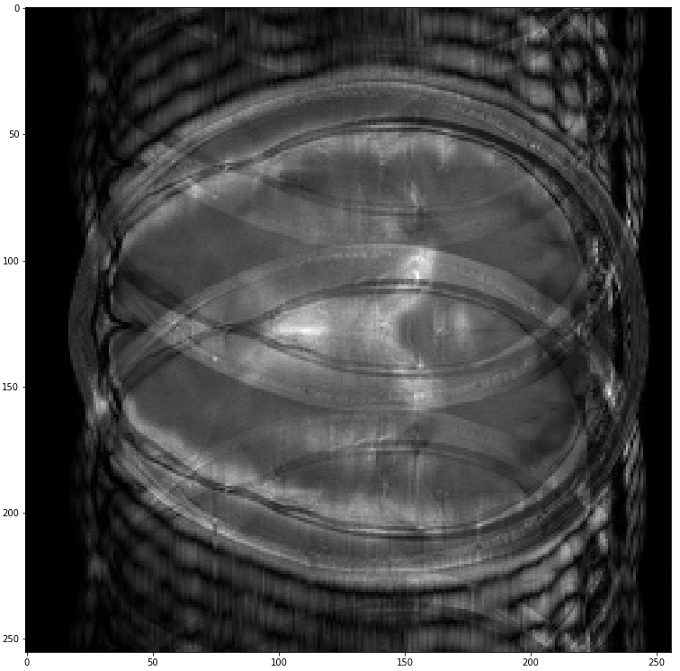
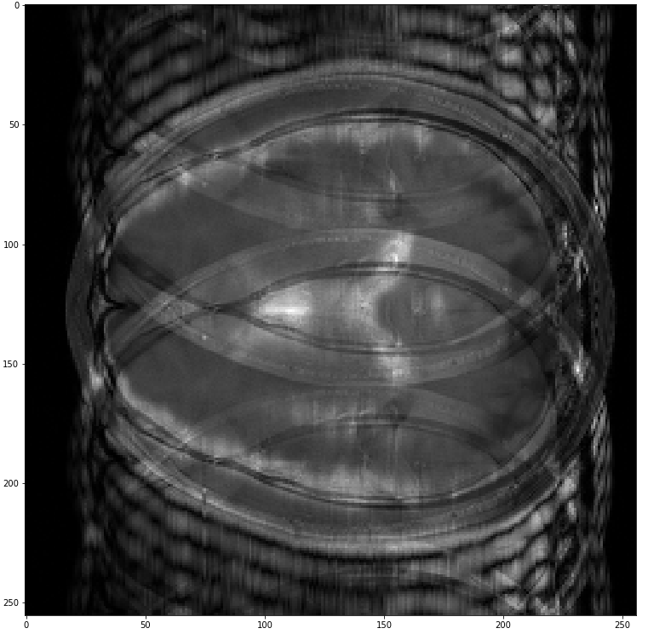
Review

Slide 4
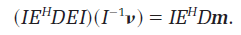
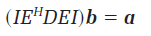
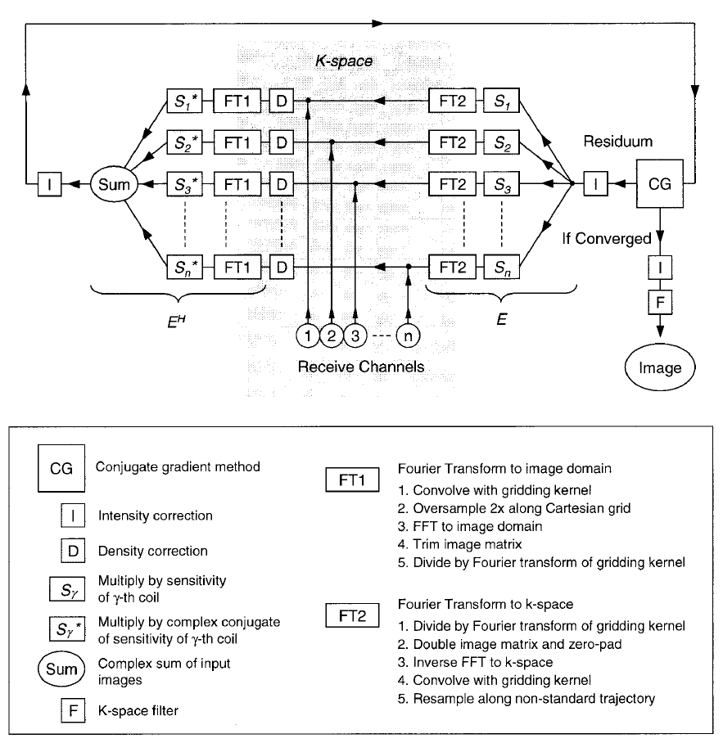
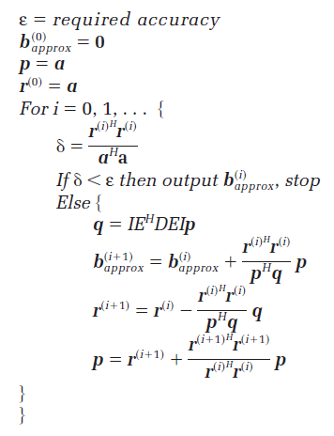
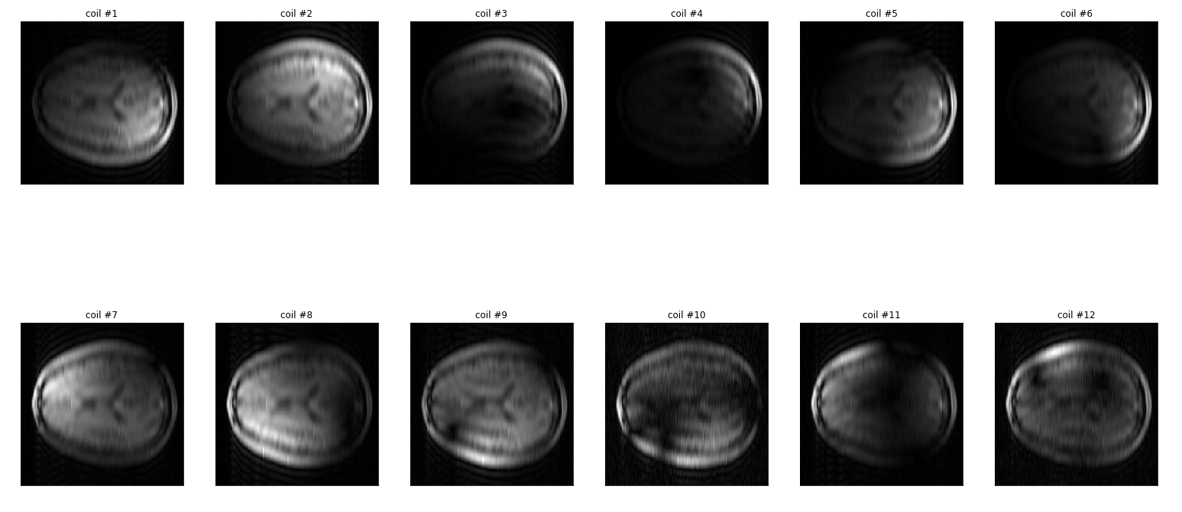
Review
Coil sensitivity
2. Cg loop
-> should be divided by rss_img
-> mask / data fidelity

Slide 5
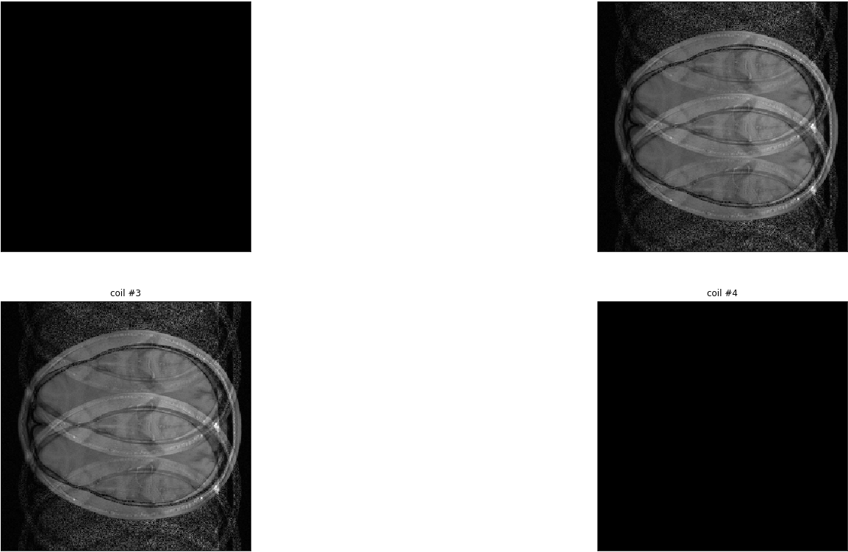
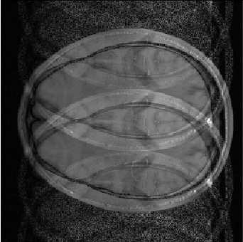
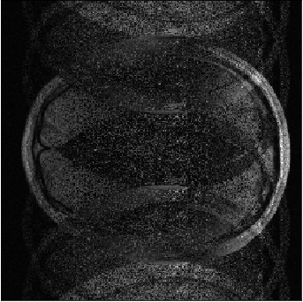
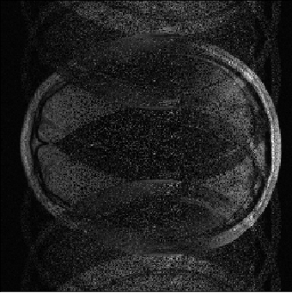
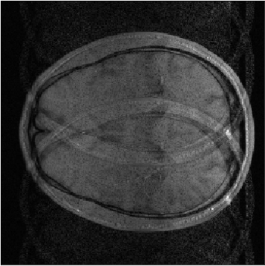
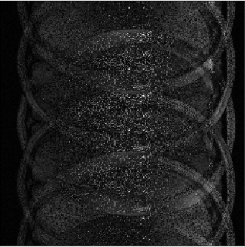
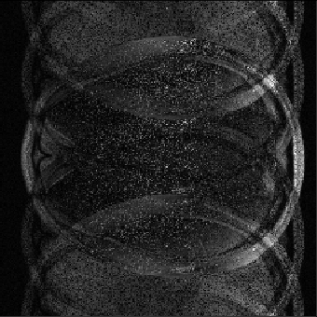
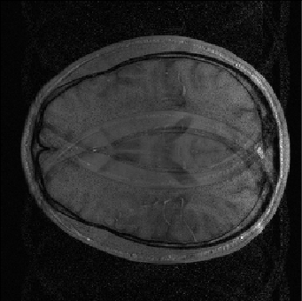
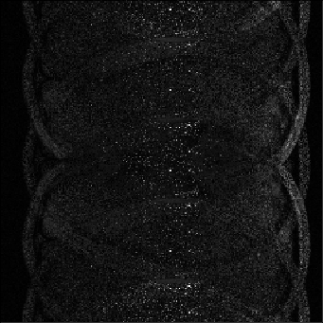
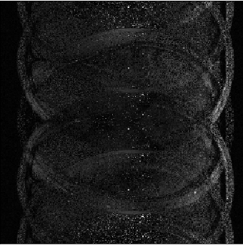
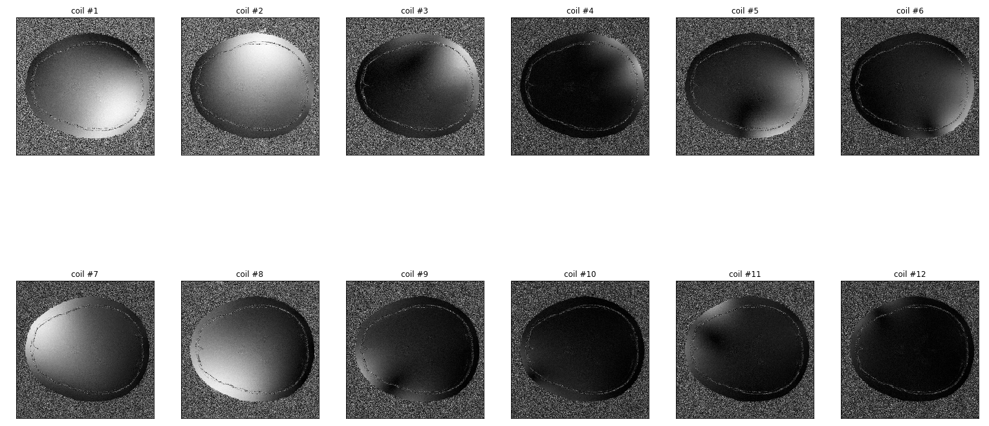
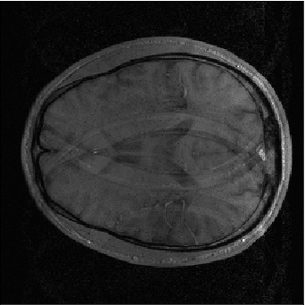
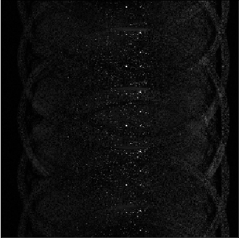
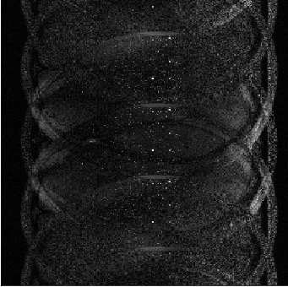
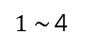
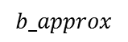
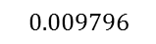
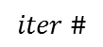
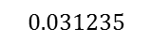
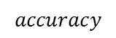
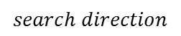


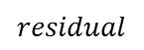
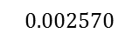
Troubleshooting_ a) CG loop
$$iter \#$$
$$b_approx$$
$$residual$$
$$search direction$$
$$accuracy$$
Coil sensitivity : full sampling
Decorrelation : X
R = 4
$$1$$
$$0.031235$$
$$0.009796$$
$1 \sim$4
$$0.002570$$
$$0.001231$$

Slide 6
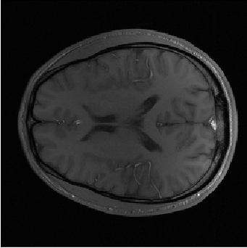
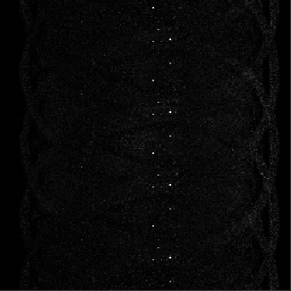
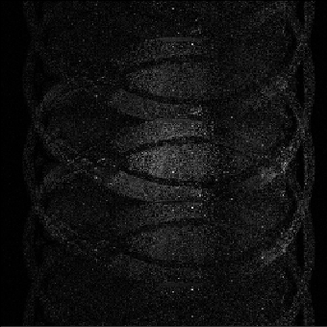
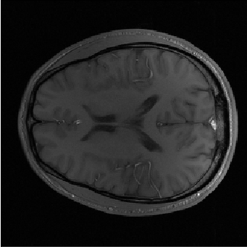
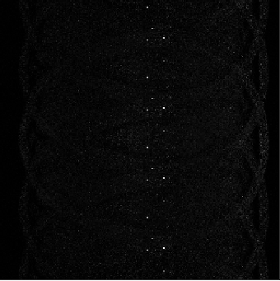
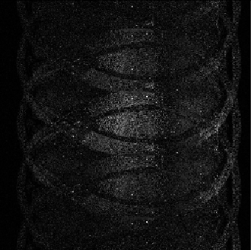
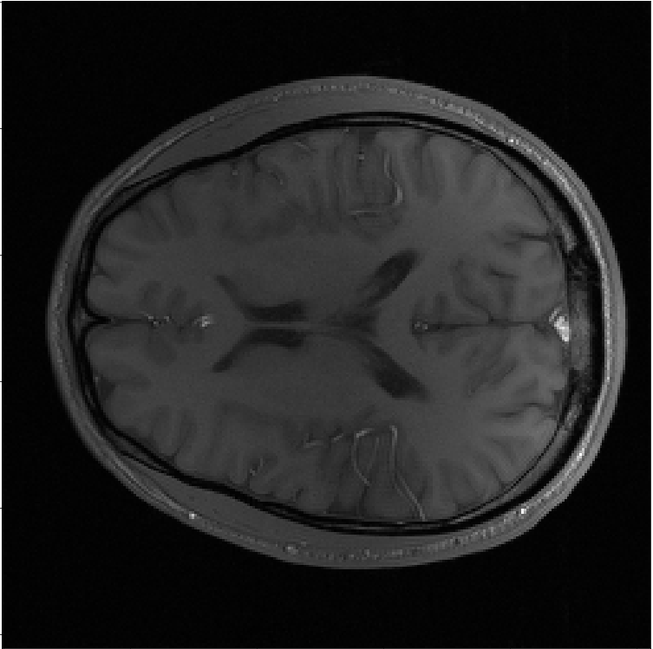

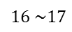

Troubleshooting_ a) CG loop
$$iter \#$$
$$b_approx$$
$$residual$$
$$search direction$$
$$accuracy$$
Coil sensitivity : full sampling
Decorrelation : X
R = 4
$${1.6e}^{−6}$$
$$16 \sim 17$$
$$9e^{−7}$$

Slide 7

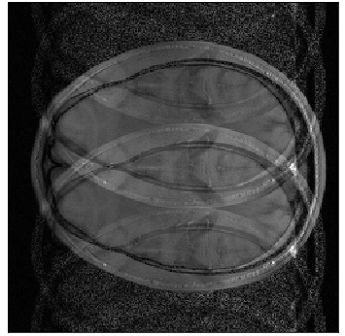
















Troubleshooting_ b) coil sensitivity
$$iter \#$$
$$b_approx$$
$$residual$$
$$search direction$$
$$accuracy$$
Coil sensitivity : low freq (20 lines)
Decorrelation : X
R = 4
$$1$$
$$1$$
$$0.025084$$
$$6$$
$$0.000347$$
$$11$$
$$4.7e^{−5}$$

Slide 8














Troubleshooting _ b) coil sensitivity
$$iter \#$$
$$b_approx$$
$$residual$$
$$search direction$$
$$accuracy$$
Coil sensitivity : full sampling
Decorrelation : X
R = 4
$$16$$
$${8.3e}^{−6}$$
$$23$$
$$8.9e^{−7}$$
$$iter=11$$
$$accu=4.7e^{−5}$$
$$R=4$$
$$iter=23$$
$$accu=8.9e^{−7}$$
$$R=4$$
$$iter=12$$
$$accu=6.4e^{−7}$$
$$R=2$$

Slide 9


















Troubleshooting _ b) coil sensitivity
$$iter \#$$
$$b_approx$$
$$residual$$
$$search direction$$
$$accuracy$$
Coil sensitivity : full sampling
Decorrelation : O
R = 4
$$1\sim 4$$
$$0.064646$$
$$0.023933$$
$$0.008933$$
$$0.004924$$

Slide 10





Troubleshooting _ b) coil sensitivity
$$iter \#$$
$$b_approx$$
$$residual$$
$$search direction$$
$$accuracy$$
Coil sensitivity : full sampling
Decorrelation : O
R = 4
$$20$$
$$0.002570$$

Slide 11




Troubleshooting _ b) coil sensitivity
Decorrelation step
Noise covariance
L_inv

Slide 12

















Troubleshooting _ c) parameter adjustment
# of low freq lines
Decorrelation : X
Accuracy = 1e^-6
R = 4
[256 x 256]
$$20$$
$$(23)$$
$$120$$
$$(21)$$
$$256$$
$$(20)$$
$$40$$
$$(21)$$
$$160$$
$$(21)$$
$$\begin{aligned} lowfrq line \#\end{aligned}$$
$$(iter)$$
$$80$$
$$(20)$$
$$200$$
$$(20)$$
$$reference$$

Slide 13














Troubleshooting _ c) parameter adjustment
$$20$$
$$(23)$$
$$120$$
$$(21)$$
$$256$$
$$(20)$$
# of low freq lines
Decorrelation : X
Accuracy = 1e^-6
R = 4
[256 x 256]
$$40$$
$$(21)$$
$$160$$
$$(21)$$
$$\begin{aligned} lowfrq line \#\end{aligned}$$
$$(iter)$$
$$80$$
$$(20)$$
$$200$$
$$(20)$$
$$reference$$

Slide 14



















Troubleshooting _ c) parameter adjustment
Reduction factor(R)
Decorrelation : X
Accuracy = 1e^-6
# of low freq lines = 40/256
[256 x 256]
$$2$$
$$(10)$$
$$\# of lowfrq=40$$
$$2$$
$$(9)$$
$$\# of lowfrq=256$$
$$4$$
$$(21)$$
$$4$$
$$(19)$$
$$\begin{aligned} R\#\end{aligned}$$
$$(iter)$$
$$8$$
$$(50)$$
$$8$$
$$(40)$$
$$reference$$

Slide 15
Next meeting
- Radial data(gridding implementation)

